Slide 1
CONTENT
9.1 Styling Links
9.2 Styling Lists
9.3 Styling Tables
9.4 CSS Box Model

Slide 2
9.1 Styling Links
Links can be styled with any CSS property (e.g. color, font-family, background, etc.).
Special for links are that they can be styled differently depending on what state they are in.
The four links states are:
a:link - a normal, unvisited link
a:visited - a link the user has visited
a:hover - a link when the user mouses over it
a:active - a link the moment it is clicked
Example:
a:link {color:#FF0000;} /* unvisited link */ a:visited {color:#00FF00;} /* visited link */ a:hover {color:#FF00FF;} /* mouse over link */ a:active {color:#0000FF;} /* selected link */
When setting the style for several link states, there are some order rules:
a:hover MUST come after a:link and a:visited
a:active MUST come after a:hover

Slide 3
9.1 Styling Links
Text Decoration
The text-decoration property is mostly used to remove underlines from links:
Example:
a:link {text-decoration:none;} a:visited {text-decoration:none;} a:hover {text-decoration:underline;} a:active {text-decoration:underline;}
Background Color
The background-color property specifies the background color for links:
Example:
a:link {background-color:#B2FF99;} a:visited {background-color:#FFFF85;} a:hover {background-color:#FF704D;} a:active {background-color:#FF704D;}

Slide 4
9.1 Styling Links
Example 1 – Adding different styles to hyperlinks:
<html>
<head>
<style type="text/css">
a.one:link {color:#ff0000;}
a.one:visited {color:#0000ff;}
a.one:hover {color:#ffcc00;}
a.two:link {color:#ff0000;}
a.two:visited {color:#0000ff;}
a.two:hover {font-size:150%;}
a.three:link {color:#ff0000;}
a.three:visited {color:#0000ff;}
a.three:hover {background:#66ff66;}
a.four:link {color:#ff0000;}
a.four:visited {color:#0000ff;}
a.four:hover {font-family:monospace;}
a.five:link {color:#ff0000;text-decoration:none;}
a.five:visited {color:#0000ff;text-decoration:none;}
a.five:hover {text-decoration:underline;}
</style>
</head>

Slide 5
9.2 Styling Lists
The CSS list properties allow you to:
Set different list item markers for ordered lists
Set different list item markers for unordered lists
Set an image as the list item marker
In HTML, there are two types of lists:
unordered lists - the list items are marked with bullets
ordered lists - the list items are marked with numbers or letters
With CSS, lists can be styled further, and images can be used as the list item marker.
The type of list item marker is specified with the list-style-type property:
Example:
ul.a {list-style-type: circle;} ul.b {list-style-type: square;} ol.c {list-style-type: upper-roman;} ol.d {list-style-type: lower-alpha;}

Slide 6
9.2 Styling Lists
An Image as The List Item Marker
To specify an image as the list item marker, use the list-style-image property:
Example:
ul { list-style-image: url('sqpurple.gif'); }
The example above does not display equally in all browsers. IE and Opera will display the image-marker a little bit higher than Firefox, Chrome, and Safari.
If you want the image-marker to be placed equally in all browsers, you should use a crossbrowser solution which is explained below.

Slide 7
9.3 Styling Tables
Table Borders
To specify table borders in CSS, use the border property.
The example below specifies a black border for table, th, and td elements:
Example
table, th, td { border: 1px solid black; }
Notice that the table in the example above has double borders. This is because both the table and the th/td elements have separate borders.
To display a single border for the table, use the border-collapse property.

Slide 8
9.3 Styling Tables
Collapse Borders
The border-collapse property sets whether the table borders are collapsed into a single border or separated:
Example:
table { border-collapse:collapse; } table,th, td { border: 1px solid black; }

Slide 9
9.3 Styling Tables
Table Width and Height
Width and height of a table is defined by the width and height properties.
The example below sets the width of the table to 100%, and the height of the th elements to 50px:
Example:
table { width:100%; } th { height:50px; }

Slide 10
9.3 Styling Tables
Table Text Alignment
The text in a table is aligned with the text-align and vertical-align properties.
The text-align property sets the horizontal alignment, like left, right, or center:
Example
td { text-align:right; }
The vertical-align property sets the vertical alignment, like top, bottom, or middle:
Example
td { height:50px; vertical-align:bottom; }

Slide 11
9.3 Styling Tables
Table Padding
To control the space between the border and content in a table, use the padding property on td and th elements:
Example:
td { padding:15px;}
Table Color
The example below specifies the color of the borders, and the text and background color of th elements:
Example:
table, td, th { border:1px solid green;} th { background-color:green;color:white;}

Slide 12
9.4 CSS Box Model
The CSS Box Model
In CSS, the term "box model" is used when talking about design and layout.
The CSS box model is essentially a box that wraps around HTML elements, and it consists of:
margins,
borders,
padding,
and the actual content.
The box model allows us to place a border around elements and space elements in relation to other elements.

Slide 13
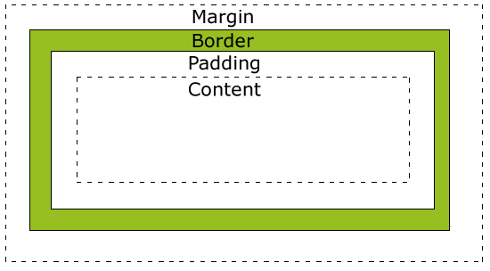
9.4 CSS Box Model
The CSS Box Model
The image below illustrates the box model:
Margin - Clears an area
around the border. The
margin does not have a
background color, it is
completely transparent.
Border - A border that
goes around the padding
and content. The border is
affected by the background
color of the box.
Padding - Clears an area around the content. The padding is affected by the background color of the box.
Content - The content of the box, where text and images appear.

Slide 14
9.4 CSS Box Model
Width and Height of an Element
When you set the width and height properties of an element with CSS, you just set the width and height of the content area.
To calculate the full size of an element, you must also add the padding, borders and margins.
The total width of the element in the example below is 300px:
width:250px; padding:10px; border:5px solid gray; margin:10px;
Let's do the math:
250px (width) + 20px (left and right padding) + 10px (left and right border) + 20px (left and right margin) = 300px

Slide 15
9.4 CSS Box Model
Width and Height of an Element
Assume that you had only 250px of space. Let's make an element with a total width of 250px:
Example
width:220px; padding:10px; border:5px solid gray; margin:0px;
The total width of an element should be calculated like this:
Total element width = width + left padding + right padding + left border + right border + left margin + right margin
The total height of an element should be calculated like this:
Total element height = height + top padding + bottom padding + top border + bottom border + top margin + bottom margin

Slide 16
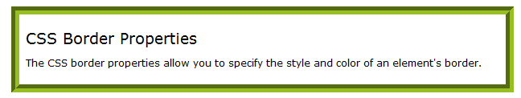
9.4 CSS Box Model
CSS Border Properties
The CSS border properties allow you to specify the style and color of an element's border.

Slide 17
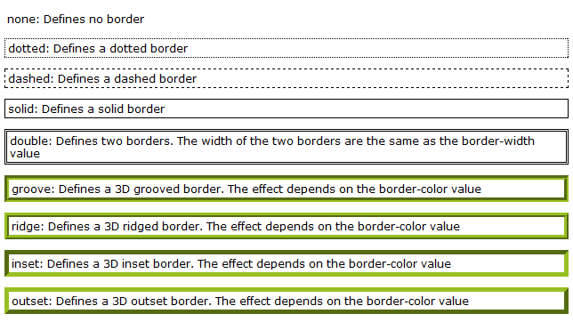
9.4 CSS Box Model
CSS Border - Style
The border-style property specifies what kind of border to display.
None of the border properties will have ANY effect unless the border-style property is set!
border-style values:

Slide 18
9.4 CSS Box Model
CSS Border - Width
The border-width property is used to set the width of the border.
The width is set in pixels, or by using one of the three pre-defined values: thin, medium, or thick.
Note: The "border-width" property does not work if it is used alone. Use the "border-style" property to set the borders first.
Example:
p.one { border-style:solid; border-width:5px; } p.two { border-style:solid; border-width:medium; }

Slide 19
9.4 CSS Box Model
CSS Border - Color
The border-color property is used to set the color of the border.
The color can be set by:
name - specify a color name, like "red"
RGB - specify a RGB value, like "rgb(255,0,0)"
Hex - specify a hex value, like "#ff0000"
You can also set the border color to "transparent".
Note: The "border-color" property does not work if it is used alone. Use the "border-style" property to set the borders first.
Example:
p.one { border-style:solid; border-color:red;}
p.two { border-style:solid; border-color:#98bf21;}

Slide 20
9.4 CSS Box Model
CSS Border - Individual sides
In CSS it is possible to specify different borders for different sides:
Example:
p { border-top-style:dotted; border-right-style:solid; border-bottom-style:dotted; border-left-style:solid; }
The example above can also be set with a single property:
Example
border-style:dotted solid;

Slide 21
9.4 CSS Box Model
The border-style property can have from one to four values.
border-style:dotted solid double dashed;
top border is dotted
right border is solid
bottom border is double
left border is dashed
border-style:dotted solid double;
top border is dotted
right and left borders are solid
bottom border is double
border-style:dotted solid;
top and bottom borders are dotted
right and left borders are solid
border-style:dotted;
all four borders are dotted
The border-style property is used in the example above. However, it also works with border-width and border-color.

Slide 22
9.4 CSS Box Model
CSS Border - Shorthand property
As you can see from the examples above, there are many properties to consider when dealing with borders.
To shorten the code, it is also possible to specify all the border properties in one property. This is called a shorthand property.
The shorthand property for the border properties is "border":
Example
border:5px solid red;
When using the border property, the order of the values are:
border-width
border-style
border-color
It does not matter if one of the values above are missing (although, border-style is required), as long as the rest are in the specified order.

Slide 23
9.4 CSS Box Model
CSS – Outlines
An outline is a line that is drawn around elements, outside the border edge, to make the element "stand out".
The outline properties specifies the style, color, and width of an outline.
Outline property is different from the border property.
The outline is not a part of the element's dimensions, therefore the element's width and height properties do not contain the width of the outline.

Slide 24
9.4 CSS Box Model
All CSS Outline Properties
Property | Description | Values
outline | Sets all the outline properties in one declaration | outline-color, outline-style outline-width
outline-color | Sets the color of an outline | color_name, hex_number, rgb_number, invert
outline-style | Sets the style of an outline | None, dotted, dashed, solid, double, groove, ridge, inset, outset, inherit
outline-width | Sets the width of an outline | Thin, medium, thick, length, inherit

Slide 25
9.4 CSS Box Model
Value | Description
auto | The browser sets the margin. The result of this is dependant of the browser
length | Defines a fixed margin (in pixels, pt, em, etc.)
% | Defines a margin in % of the containing element
CSS Margin:
The CSS margin properties define the space around elements.
The margin clears an area around an element (outside the border).
The margin does not have a background color, and is completely transparent.
The top, right, bottom, and left margin can be changed independently using separate properties.
A shorthand margin property can also be used, to change all margins at once.
It is possible to use negative values, to overlap content.
Possible Values

Slide 26
9.4 CSS Box Model
Margin - Individual sides
In CSS, it is possible to specify different margins for different sides:
Example
margin-top:100px; margin-bottom:100px; margin-right:50px; margin-left:50px;
Margin - Shorthand property
To shorten the code, it is possible to specify all the margin properties in one property. This is called a shorthand property.
The shorthand property for all the margin properties is "margin":
Example
margin:100px 50px;

Slide 27
9.4 CSS Box Model
The margin property can have from one to four values;
margin:25px 50px 75px 100px;
top margin is 25px
right margin is 50px
bottom margin is 75px
left margin is 100px
margin:25px 50px 75px;
top margin is 25px
right and left margins are 50px
bottom margin is 75px
margin:25px 50px;
top and bottom margins are 25px
right and left margins are 50px
margin:25px;
all four margins are 25px

Slide 28
9.4 CSS Box Model
All CSS Margin Properties
Property | Description
margin | A shorthand property for setting the margin properties in one declaration
margin-bottom | Sets the bottom margin of an element
margin-left | Sets the left margin of an element
margin-right | Sets the right margin of an element
margin-top | Sets the top margin of an element

Slide 29
9.4 CSS Box Model
CSS Padding
The CSS padding properties define the space between the element border and the element content.
The padding clears an area around the content (inside the border) of an element.
The padding is affected by the background color of the element.
The top, right, bottom, and left padding can be changed independently using separate properties.
A shorthand padding property can also be used, to change all paddings at once.
Value | Description
length | Defines a fixed padding (in pixels, pt, em, etc.)
% | Defines a padding in % of the containing element

Slide 30
9.4 CSS Box Model
CSS Padding - Individual sides
In CSS, it is possible to specify different padding for different sides:
Example
padding-top:25px; padding-bottom:25px; padding-right:50px; padding-left:50px;
CSS Padding - Shorthand property
To shorten the code, it is possible to specify all the padding properties in one property. This is called a shorthand property.
The shorthand property for all the padding properties is "padding":
padding:25px 50px;

Slide 31
9.4 CSS Box Model
The padding property can have from one to four values.
padding:25px 50px 75px 100px;
top padding is 25px
right padding is 50px
bottom padding is 75px
left padding is 100px
padding:25px 50px 75px;
top padding is 25px
right and left paddings are 50px
bottom padding is 75px
padding:25px 50px;
top and bottom paddings are 25px
right and left paddings are 50px
padding:25px;
all four paddings are 25px

Slide 32
9.4 CSS Box Model
All CSS Padding Properties
Property | Description
padding | A shorthand property for setting all the padding properties in one declaration
padding-bottom | Sets the bottom padding of an element
padding-left | Sets the left padding of an element
padding-right | Sets the right padding of an element
padding-top | Sets the top padding of an element

